Slide 1

Underfitting, Overfitting, and How to Avoid Them in Machine Learning
Machine learning models aim to learn patterns from training data and generalize well to unseen data. However, two common issues can arise: underfitting and overfitting. Finding the right balance is crucial for model performance.

Slide 2




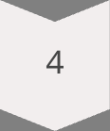
Agenda: What We'll Cover
Understanding the Fundamentals
What is underfitting and why it occurs in machine learning models
Exploring Common Pitfalls
What is overfitting and the reasons behind this frequent modeling issue
Practical Solutions
How to avoid underfitting and overfitting using proven strategies
Implementation Guide
Python techniques to implement solutions for better model performance

Slide 3

Understanding Machine Learning Models
1
Goal of Machine Learning
2
The Bias-Variance Tradeoff
Machine learning models aim to discover patterns in training data that will generalize to unseen data, striking a balance between simplicity and complexity.
Models constantly navigate the tradeoff between bias (simplifying assumptions) and variance (sensitivity to training data variations).
3
Finding the Sweet Spot
The ideal model is complex enough to capture underlying patterns but simple enough to generalize beyond the training examples.

Slide 4
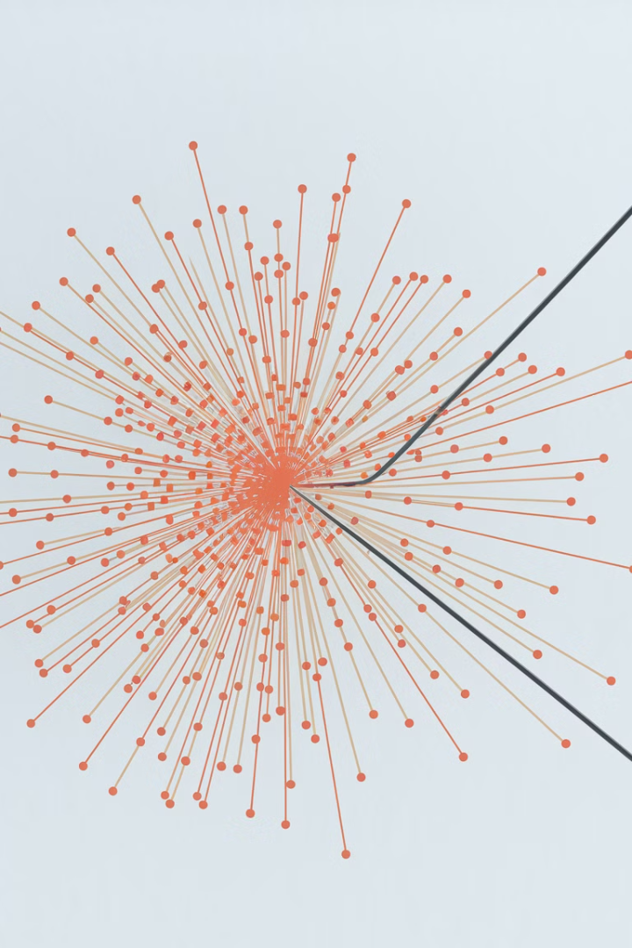
What is Underfitting?
Definition
The Root Issue
Underfitting occurs when a machine learning model is too simple to capture the underlying structure of the data, resulting in poor performance on both training and test datasets.
The model makes too many simplifying assumptions about the data, failing to recognize important patterns that exist in the dataset.
Performance Indicators
An underfit model shows consistently high error rates during both training and evaluation phases, indicating fundamental inadequacy in learning capability.

Slide 5





Characteristics of Underfitting
High Bias
Poor Performance
Insufficient Complexity
Makes too many simplifying assumptions about the data, preventing it from learning the true underlying patterns.
Shows high error rates on both training and test datasets, indicating fundamental inadequacy in capturing relationships.
Lacks the necessary parameters or flexibility to model the complexity present in the actual data distribution.
Misses Relationships
Fails to capture important non-linear or complex relationships between features and target variables.

Slide 6





Why Does Underfitting Occur?
Insufficient Training
Oversimplified Model
Not training the model long enough to learn patterns
2
Using a linear model for inherently nonlinear relationships
1
Excessive Regularization
Too much penalty forcing the model to ignore important signals
3
Data Quality Issues
5
Noisy or insufficient data preventing proper learning
Poor Feature Selection
4
Missing important features or using irrelevant ones

Slide 7
How to Tackle Underfitting - Part 1
Use More Complex Models
Increase Training Duration
Reduce Regularization
If linear models underfit, transition to more flexible algorithms like polynomial regression, decision trees, or neural networks that can capture nonlinear relationships in the data.
Extend the training process, especially for deep learning models. Increase the number of epochs to allow the model sufficient time to learn the underlying patterns in the data.
If regularization parameters (like λ in L1/L2 regularization) are too high, reduce them to allow the model more flexibility in fitting to important patterns in the training data.

Slide 8

How to Tackle Underfitting - Part 2
Feature Engineering
Create new features that help the model better understand the underlying patterns. This might include transformations, interactions, or domain-specific features that capture important relationships in the data.
Add More Features
Ensure all relevant features are included in your model. Sometimes underfitting occurs simply because important predictive variables are missing from the analysis.
Use Non-Linear Algorithms
If data has complex relationships, switch to algorithms inherently capable of modeling non-linearity, such as Random Forests, SVMs with RBF kernels, or neural networks with appropriate activation functions.

Slide 9
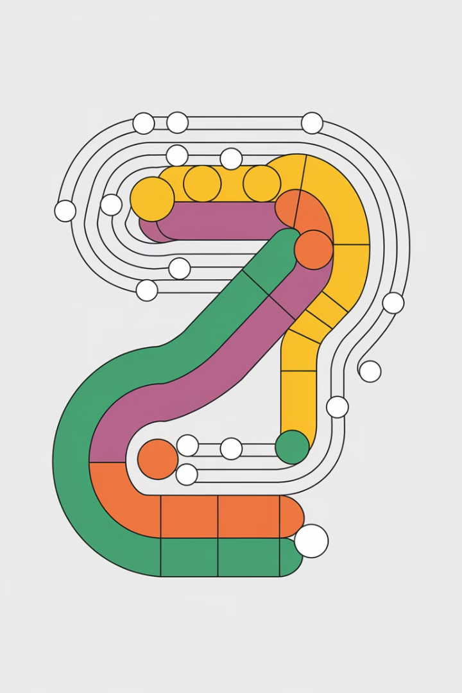
What is Overfitting?
Definition
The Core Problem
Overfitting happens when a machine learning model learns the training data too well, including noise and random fluctuations, resulting in poor generalization to new data.
The model essentially memorizes the training examples instead of learning general patterns, making it highly accurate on training data but unreliable on unseen data.
Performance Indicators
An overfit model shows very low error on training data but significantly higher error on validation or test data, revealing its failure to generalize properly.

Slide 10





Characteristics of Overfitting
High Variance
Training-Test Gap
Noise Memorization
Excessive Detail
Shows excessive sensitivity to fluctuations in the training data, making the model unstable when presented with new examples.
Exhibits excellent performance on training data but significantly worse performance on test data, indicating poor generalization.
Learns and incorporates random noise or outliers in the training data as if they were meaningful patterns to be replicated.
Captures too many specific details of the training examples at the expense of learning broader, more generalizable patterns.

Slide 11





Why Does Overfitting Occur?
Feature Overload
Excessive Model Complexity
Including too many features, especially irrelevant ones, giving the model too many dimensions to fit noise rather than signal.
Using deep neural networks or high-degree polynomials when a simpler model would capture the true relationship more effectively.
2
1
Data Scarcity
3
Having insufficient training examples relative to model complexity, making it easier to memorize than generalize.
Excessive Training
5
Training for too many iterations, allowing the model to progressively fit to noise after capturing the true patterns.
4
Insufficient Regularization
Lacking appropriate constraints that would prevent the model from fitting to noise in the training data.

Slide 12
How to Tackle Overfitting - Part 1
Simplify Your Model
Gather More Training Data
Apply Regularization
Reduce the complexity by limiting deep layers in neural networks, decreasing polynomial degrees, or pruning decision trees. Choose the simplest model that adequately captures the relationship in your data.
Increase your dataset size through additional data collection or augmentation techniques (especially useful for image data). More diverse training examples make memorization harder and generalization more likely.
Implement L1 (Lasso) or L2 (Ridge) regularization to penalize large coefficients and encourage simpler models. For neural networks, techniques like dropout randomly disable nodes during training to improve generalization.

Slide 13

How to Tackle Overfitting - Part 2
1
Feature Selection and Reduction
Systematically identify and remove irrelevant or redundant features using techniques like PCA, feature importance ranking, or L1 regularization. Fewer features mean fewer opportunities for the model to fit to noise.
2
Early Stopping
Monitor validation performance during training and stop when validation error begins to increase, even if training error continues to decrease. This prevents the model from progressing into overfitting territory.
3
Cross-Validation
Implement k-fold cross-validation to ensure your model performs consistently across different subsets of data. This provides a more reliable estimate of model performance on unseen data.

Slide 14


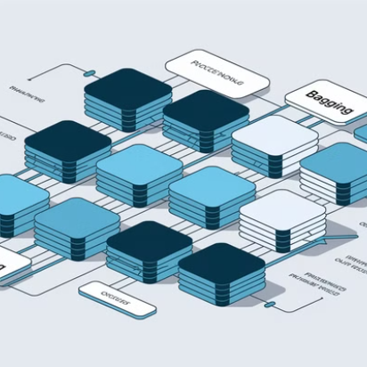

How to Tackle Overfitting - Part 3
Ensemble methods combine multiple models to improve generalization and reduce overfitting. Random Forests use bagging to train many trees on random subsets of data and features. Boosting methods like XGBoost or AdaBoost build sequential models that focus on previously misclassified examples. Stacking combines predictions from multiple different algorithms.
These techniques leverage the "wisdom of crowds" principle—combining multiple imperfect models often produces more robust predictions than any single model alone.

Slide 15

Techniques Comparison for Model Fitting
Technique
Helps with Underfitting
Helps with Overfitting
Implementation Difficulty
Increase Model Complexity
✓
✗
Medium
Regularization (L1/L2)
✗
✓
Low
Cross-Validation
-
✓
Medium
Feature Engineering
✓
-
High
Early Stopping
✗
✓
Low
Ensemble Methods
✓
✓
High
Different techniques address specific model fitting challenges. While increasing model complexity helps with underfitting, it may worsen overfitting. Conversely, regularization and early stopping primarily combat overfitting but could exacerbate underfitting if applied too aggressively.
Ensemble methods like Random Forests and Boosting offer the unique advantage of addressing both issues simultaneously, though they come with higher implementation complexity.

Slide 16




Finding the Sweet Spot: A Good Fit
Optimal Performance
1
Best generalization to new data
Balanced Complexity
2
Neither too simple nor too complex
Effective Training
3
Proper regularization and validation
Quality Data Foundation
4
Clean, representative training examples
Finding the optimal model requires balancing multiple factors. A well-fitted model starts with quality data and builds upon it with appropriate complexity and effective training procedures. This balanced approach leads to models that generalize well to unseen data.
Like the Goldilocks principle, the goal is finding what's "just right" - complex enough to capture true patterns but simple enough to ignore noise. This balance results in models that perform consistently across training and test datasets.

Slide 17
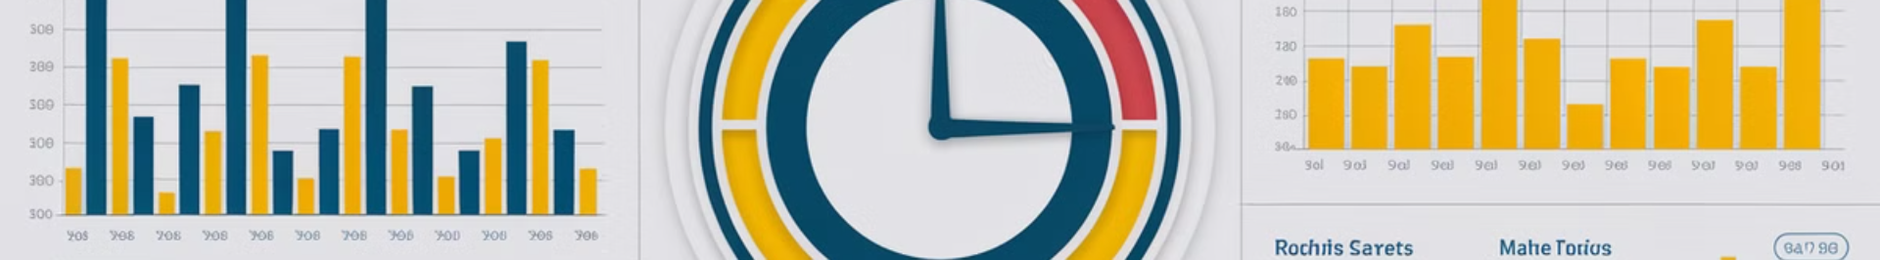
Key Performance Metrics to Monitor
2
5-10
Error Types
Cross-Validation Folds
Always monitor both training error and validation error. The gap between these metrics reveals potential overfitting issues.
Using 5-10 folds in cross-validation provides reliable performance estimates while maintaining computational efficiency.
80/20
0.95+
Train/Test Split
Target R² for Good Fit
The common ratio for dividing data between training and testing sets, though this may vary based on dataset size.
For many applications, an R-squared above 0.95 on validation data indicates a well-fitted regression model.
Monitoring these key metrics helps identify whether your model is underfitting, overfitting, or achieving a good balance. The relationship between training and validation performance is particularly revealing of your model's generalization capabilities.

Slide 18
Implementation: Learning Curves in Python
1
Import Libraries
Start by importing sklearn, matplotlib, numpy
2
Create Learning Curve Function
Define function to plot training vs validation error
3
Train Models with Different Complexities
Evaluate simple to complex models on same data
4
Analyze Curves to Diagnose Issues
Identify patterns indicating under/overfitting
Learning curves plot training and validation errors as functions of training set size. They provide visual diagnostics for identifying underfitting and overfitting. When both curves show high error, the model is underfitting. When training error is much lower than validation error, the model is overfitting.
Implementing these curves in Python is straightforward with scikit-learn's learning_curve function, allowing you to visualize how your model performs as it sees more training examples.

Slide 19




Real-World Examples: Before and After
Housing Price Prediction: Underfitting
Solution: Feature Engineering
Image Classification: Overfitting
Solution: Regularization + Augmentation
Initially, a simple linear regression model significantly underpredicted high-value properties and overpredicted low-value ones. The straight-line model couldn't capture the nonlinear relationship between home features and prices.
Adding polynomial features and interaction terms allowed the model to capture nonlinear relationships. The improved model reduced RMSE by 35% by properly modeling how features like location, size, and amenities interact to determine housing prices.
A deep CNN achieved 99.8% accuracy on training images but only 82% on test images. The model had memorized training examples instead of learning generalizable features.
Implementing dropout layers, L2 regularization, and data augmentation (rotations, flips, color variations) reduced the gap between training and test performance, improving test accuracy to 94% while slightly reducing training accuracy.

Slide 20
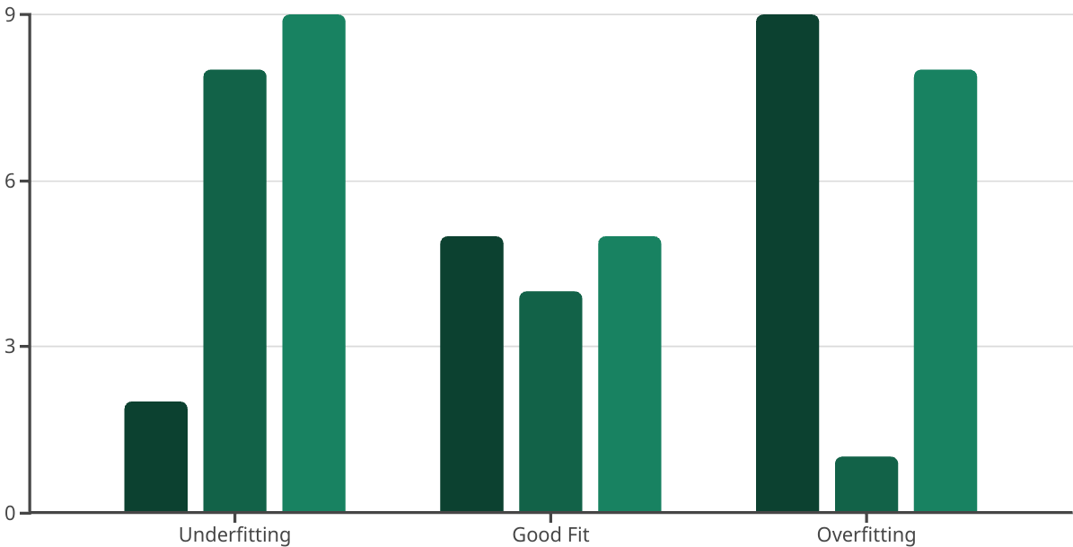
Summary: Balancing the Art and Science of Model Fitting
Complexity Level
Training Error
Test Error
Finding the optimal balance in machine learning requires both technical knowledge and intuition developed through experience. Underfitting results from models that are too simple, with high errors across both training and test data. Overfitting stems from excessive complexity, showing excellent training performance but poor generalization.
The key is systematic experimentation: start simple, gradually increase complexity while monitoring validation performance, and apply appropriate regularization techniques. Remember that the ultimate goal is not perfect training accuracy, but reliable performance on new, unseen data in real-world applications.

